Slide 1
Sudoku Solver
Project presentation
Spring semester 2015

Slide 2
Group Members
Sumit kumar 140040053
Akshatha S 140010053
Anshul Jain 140040043
Trupti Gavit 14D110003

Slide 3

Goal
Our program code is TO help you to solve your sudoku.
The program can also be used to check if a given Sudoku has a solution or not.

Slide 4
Solution is not exist if
 |  |  |  |  |  |  |  | 4
 | 8 |  |  | 6
 |  | 2
 | 3 |  |  | 5
 |  |  | 1
 |  |  |  |  |  |  | 9
 | 7
Any row or column contain same number
1
or
4
Any 3*3 box contain same number

Slide 5
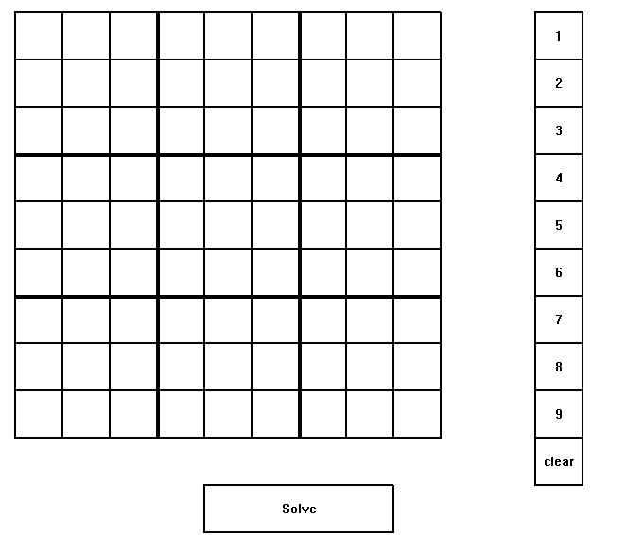
Challenges
Using initCanvas we show the grid and using arrays we stored the inputs.
Using getclick (mouseclick) we are able to get inputs.
Appearance of grid
Insertion of input.

Slide 6
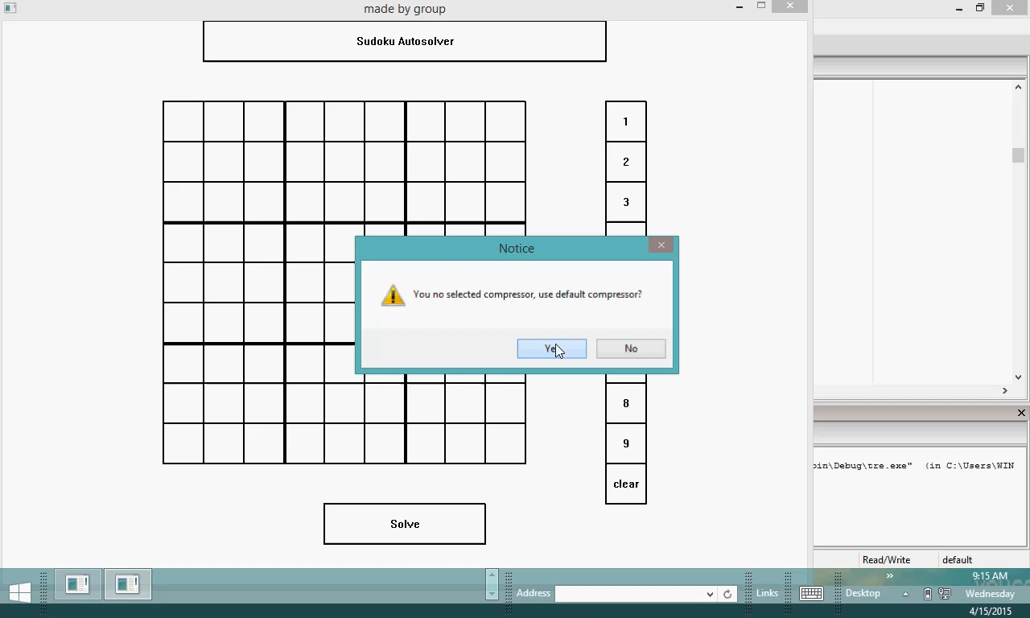

Slide 7
Other implementations
Grid
Insertion of inputs
Solving code
Testing
Code is ready for solving sudoku

Slide 8
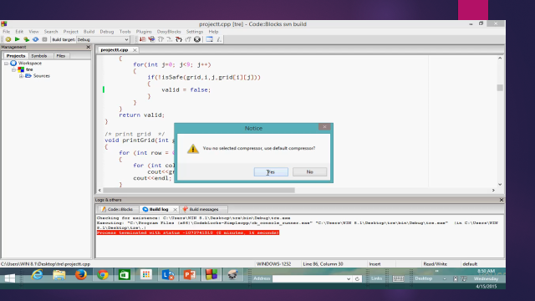
Testing

Slide 9
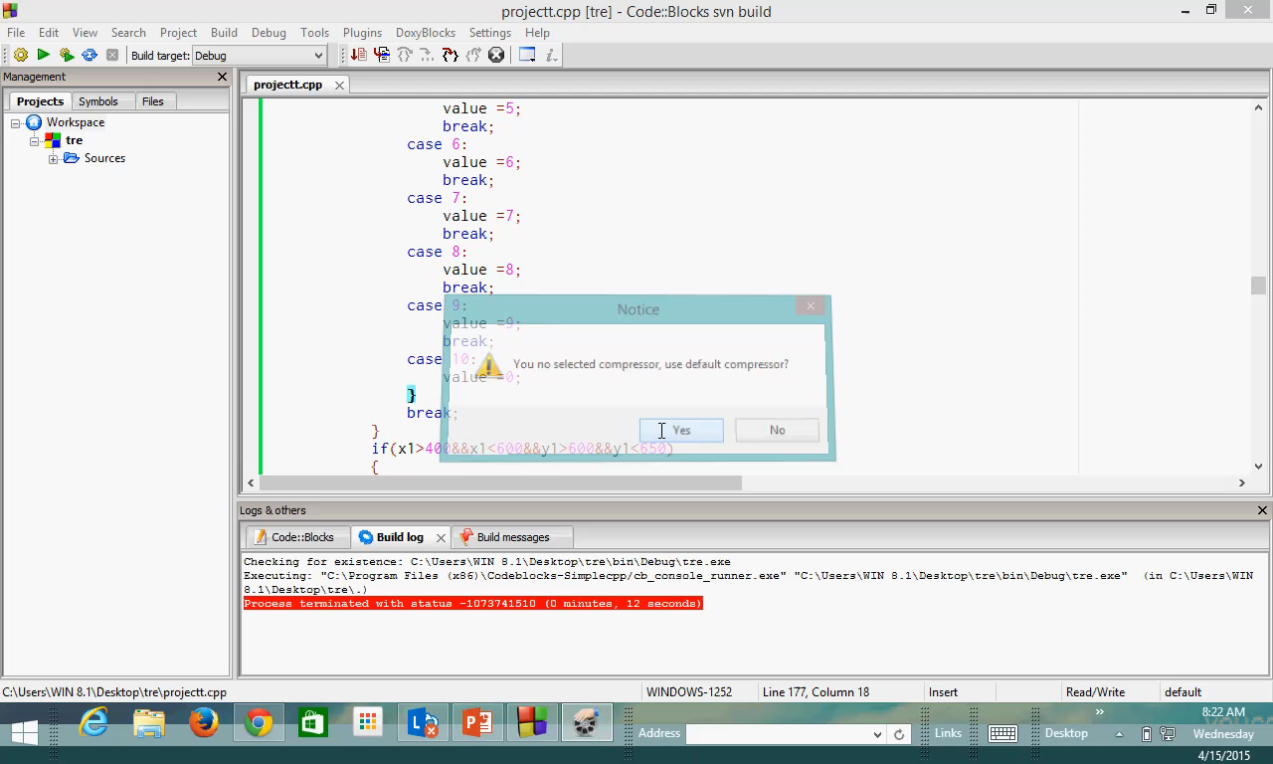

Slide 10
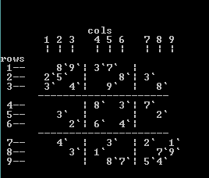
Innovation
We had used initcanvas so that it appears to user.
Our sudoku solver gives solution in few seconds.
It gives solution for every valid sudoku in which at least one entry should exist

Slide 11
Future work
The ability to choose the colours of the cells when the mouse hovers over them would be more convenient for the user.
We can add diagonal facility to it
We can make 6*6 or 12*12 grid.

Slide 12
THANK YOU
☺

